Slide 1

8th Grade Math: Pre-Algebra
Unit 10, Lesson 3 Relations and Functions Volume 2, pg. 129

Slide 2


Benchmark
MA.8.F.1.1
Given a set of ordered pairs, a table, a graph, or mapping diagram, determine whether the relationship is a function. Identify the domain and range of the relation.
volume 2, pg. 129

Slide 3
Integrated Mathematical Thinking and Reasoning Standards
MA.K12.MTR.2.1 Demonstrate understanding by representing problems in multiple ways.
MA.K12.MTR.4.1 Engage in discussions that reflect on the mathematical thinking of self and others.
MA.K12.MTR.7.1 Apply mathematics to real-world contexts.
volume 2, pg. 129

Slide 4

Learning Targets
I can identify the domain and range of a relation.
I can determine if a relation is a function.
volume 2, pg. 129

Slide 5

Warm-Up
volume 2, pg. 130

Slide 6
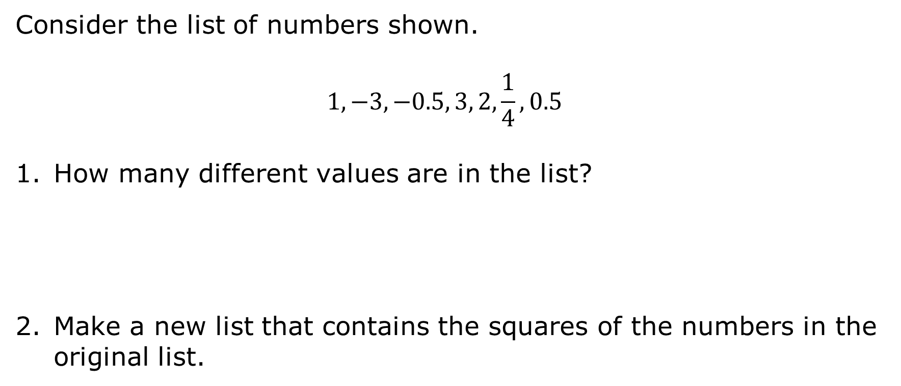
10.3.1 Warm-Up: Square Me
Consider the list of numbers shown.
$$1, −3, −0.5, 3, 2, \frac{1}{4}, 0.5$$
How many different values are in the list?
Make a new list that contains the squares of the numbers in the original list.
volume 2, pg. 130

Slide 7
How many different values are in the new list?
Compare the number of values on the original list to the number of values on the new list. What do you notice?
volume 2, pg. 130

Slide 8

Collaboration
volume 2, pg. 130

Slide 9

10.3.2 Collaboration: Exploring Relationships
The independent and dependent variables for several relationships are described. Work with your partner to come up with examples of the domain and range for each relationship. Draw arrows from the elements in the domain to the corresponding elements in the range.
Relationship A
Domain | Range
Independent Variable | Student
Dependent Variable | Hair color
volume 2, pg. 130

Slide 10
Relationship B
Domain | Range
Independent Variable | Month
Dependent Variable | Number of days in the month
volume 2, pg. 130

Slide 11
Relationship C
Domain | Range
Independent Variable | Length of a square
Dependent Variable | Area of the same square
volume 2, pg. 131

Slide 12
Relationship D
Domain | Range
Independent Variable | Length of a rectangle
Dependent Variable | Area of the same rectangle
volume 2, pg. 131

Slide 13
Relationship E
Domain | Range
Independent Variable | Student
Dependent Variable | Height
volume 2, pg. 131

Slide 14
Work with your partner to complete the following.
List the relationships for which each independent variable is paired with its own unique dependent variable.
List the relationships for which some independent variables are paired with more than one dependent variable.
volume 2, pg. 131

Slide 15
Find another pair of partners to form a group of four. Compare your responses on the previous two questions. Discuss any differences and make revisions to your work if necessary.
List any relationships for which your group cannot come to agreement.
volume 2, pg. 131

Slide 16

Bring It Together
volume 2, pg. 132

Slide 17


10.3.3 Bring It Together: Relations and Functions
Relationships C and E from the collaboration represent functions because each element in the domain corresponds to a unique element in the range.
A function is a mathematical relation for which each element in the domain corresponds to exactly one element in the range.
volume 2, pg. 132

Slide 18
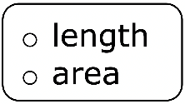
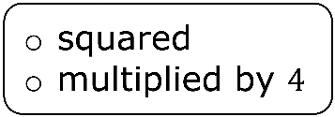
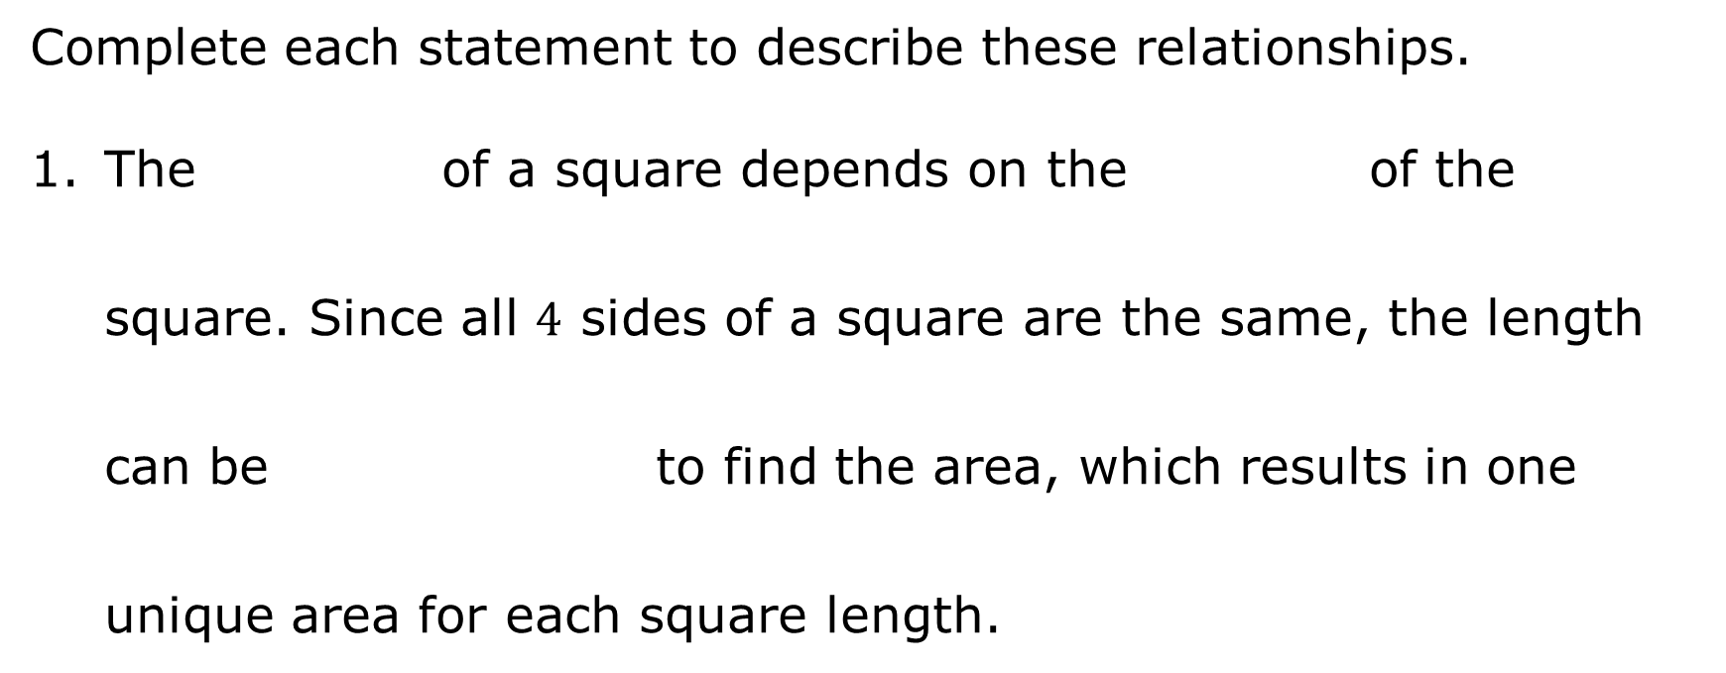
Complete each statement to describe these relationships.
The of a square depends on the of the square. Since all $4$ sides of a square are the same, the length can be to find the area, which results in one unique area for each square length.
volume 2, pg. 132

Slide 19
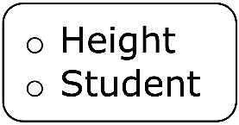
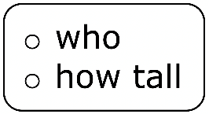
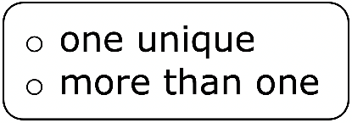
depends on the student is. Each student has height, so a student’s height is a function of who the student is.
volume 2, pg. 132

Slide 20

Guided Instruction
volume 2, pg. 132

Slide 21
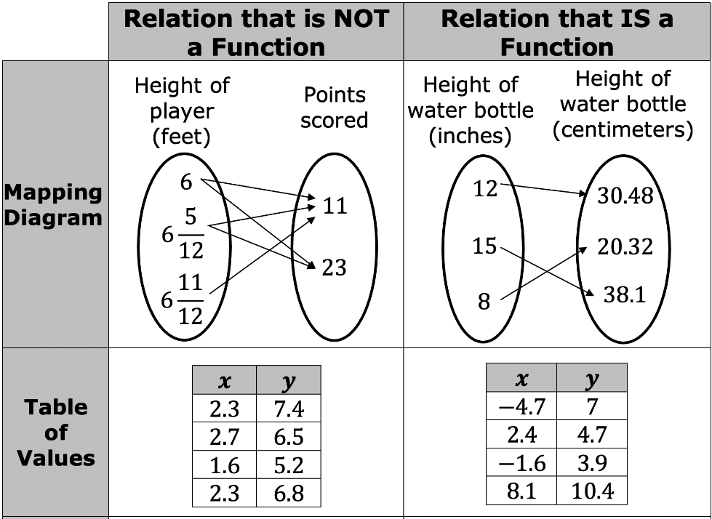
10.3.4 Guided Instruction: Determining If a Relation Is a Function
Relations and functions can be represented using a mapping diagram, a table of values, a set of ordered pairs, or on a graph.
volume 2, pg. 132

Slide 22
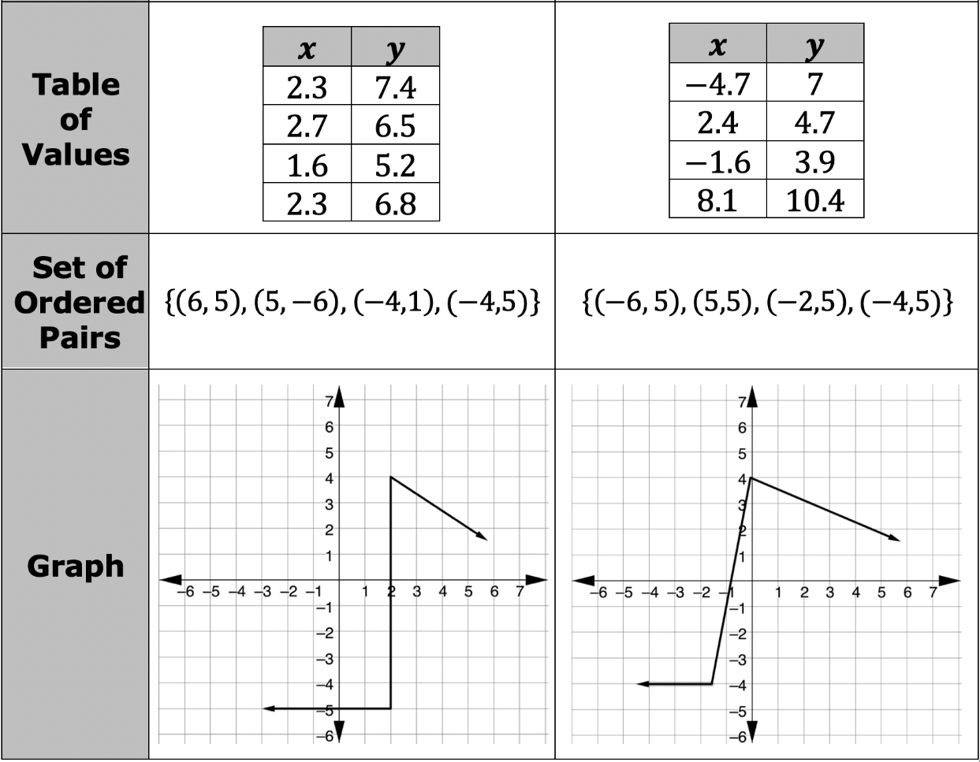
volume 2, pg. 132

Slide 23
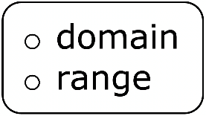
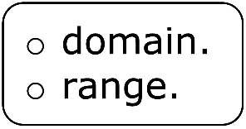
Complete the statement.
For each function represented, each element in the corresponds to only one element in the
For each relation represented that is not a function, circle the element(s) in the domain that correspond to more than one element in the range.
volume 2, pg. 133

Slide 24

Guided Practice
volume 2, pg. 133

Slide 25

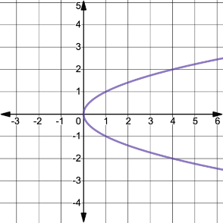
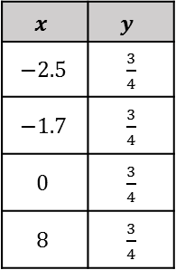
10.3.5 Guided Practice: Determining If a Relation Is a Function
Determine if each relation is a function. Then, explain your reasoning.
Relation | Description | Explanation
 | function not a function
 | function not a function
$$x$$ | $$y$$
$$−2.5$$ | $\frac{3}{4}$
$$−1.7$$ | $\frac{3}{4}$
$$0$$ | $\frac{3}{4}$
$$8$$ | $\frac{3}{4}$
volume 2, pg. 133

Slide 26

Your Turn
volume 2, pg. 134

Slide 27
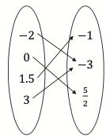
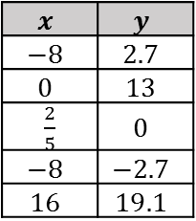
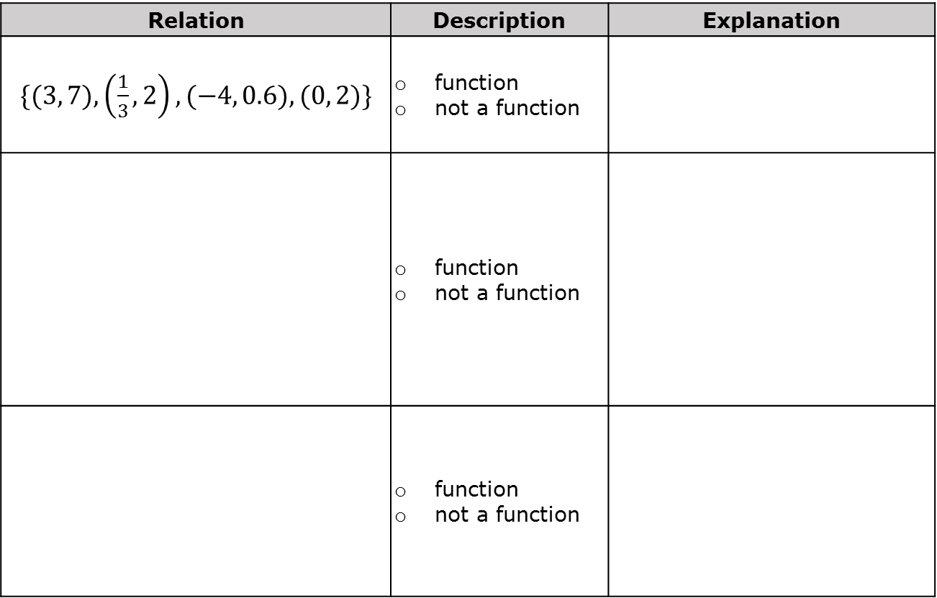
10.3.6 Your Turn!
Determine if each relation is a function. Then, explain your reasoning.
Relation | Description | Explanation
$\{(3, 7), \left(\frac{1}{3}, 2\right), (−4, 0.6), (0, 2)\}$ | function not a function
 | function not a function
 | function not a function
$$x$$ | $$y$$
$$−8$$ | $$2.7$$
$$0$$ | $$13$$
$\frac{2}{5}$ | $$0$$
$$−8$$ | $$−2.7$$
$$16$$ | $$19.1$$
volume 2, pg. 134

Slide 28

Wrap-Up
volume 2, pg. 134

Slide 29
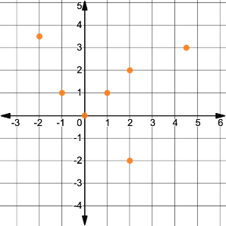
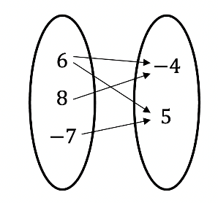
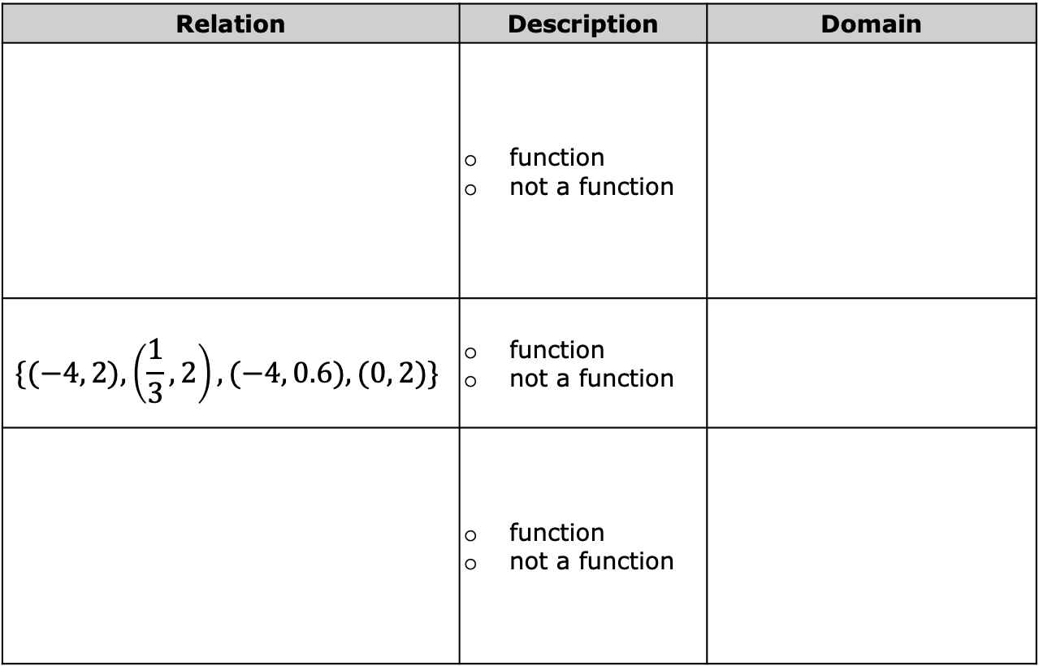
10.3.7 Wrap-Up: Ticket Out the Door
Determine if each relation is a function. Then, identify the domain.
Relation | Description | Domain
 | function not a function
$$\{(−4, 2), \left(\frac{1}{3}, 2\right), (−4, 0.6), (0, 2)\}$$ | function not a function
 | function not a function
volume 2, pg. 134

